Slide 1
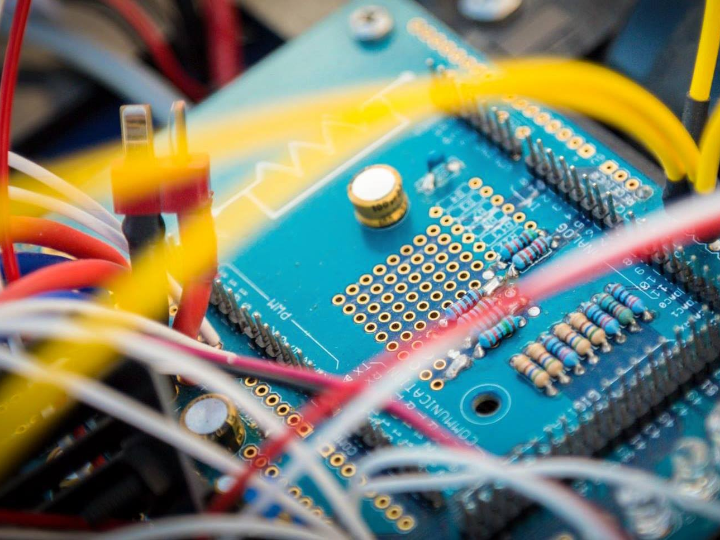
IEEE UC SAN DIEGO Student Branch

Slide 2
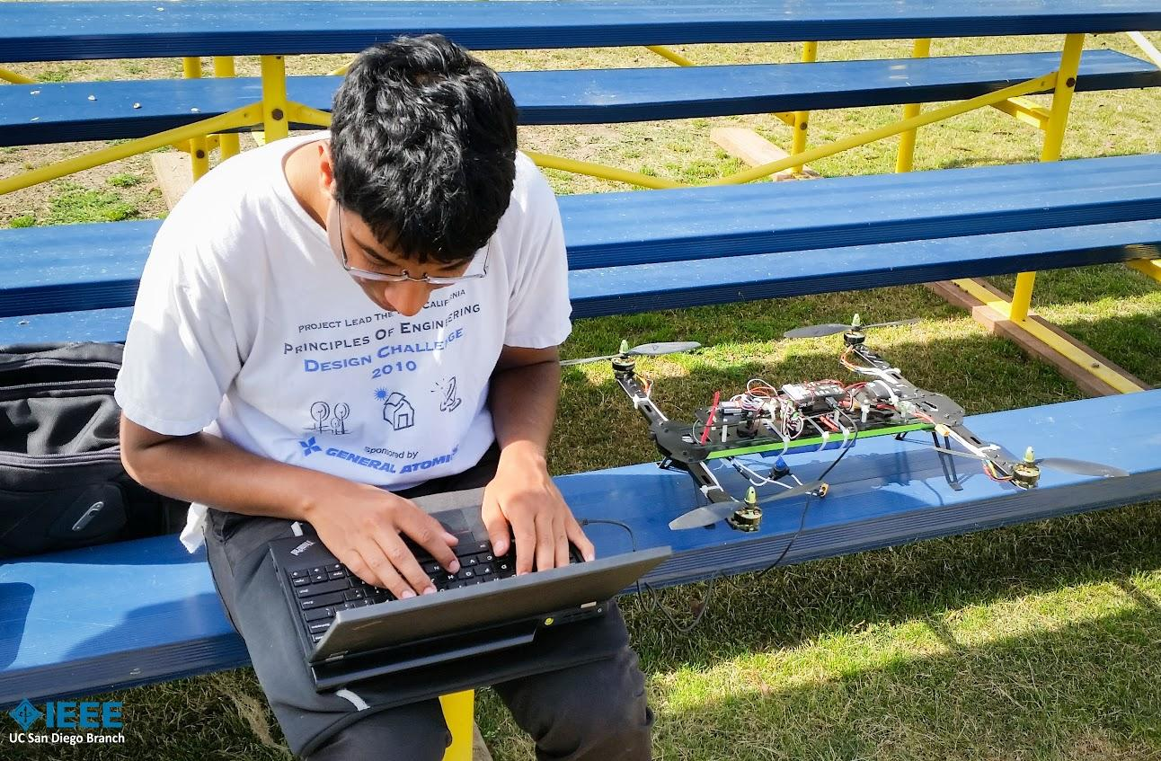
Who We Are
I
E
E
E
nstitute of
lectrical and
lectronics
ngineers
630+ student members!
Creators, Dreamers, Doers, Thinkers, Explorers, Teachers, Entrepreneurs, Family
But we have all majors!

Slide 3
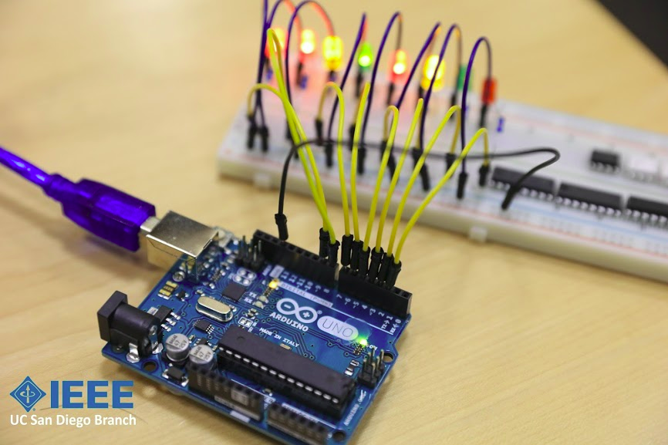
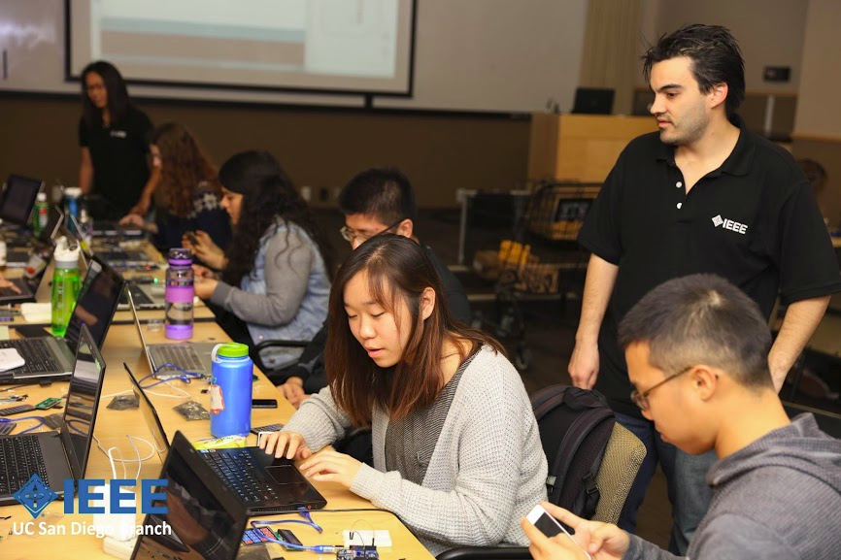
Mission Unimpossible
Develop students’ technical and Professional skills
Technical skills give students an advantage
Professional skills will help you put your best foot forward
Building a community
Shared experiences
Friendly and productive environment

Slide 4
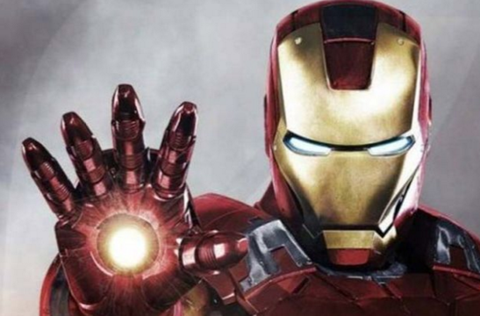
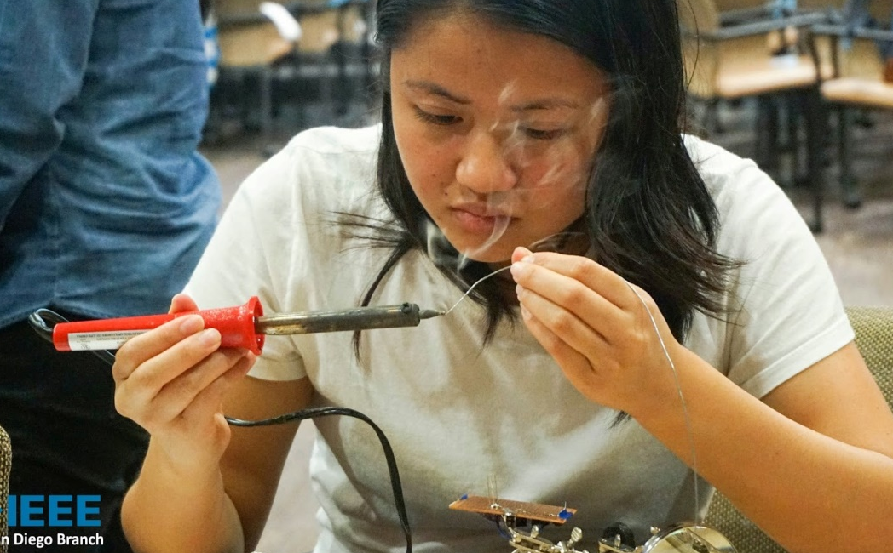
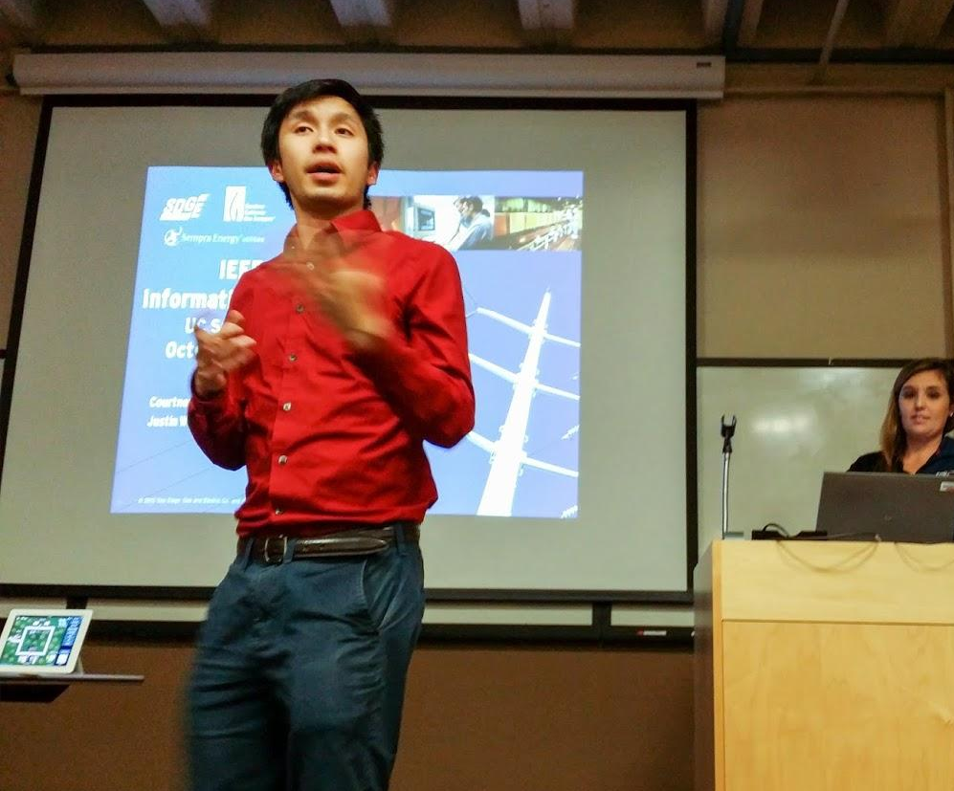
Getting Students to Love EE
Helping students realize their dreams
Hands-on projects,
Honing their skills
PCB design
Soldering
Programming
Industry Insight
ECE day
Company tours

Slide 5
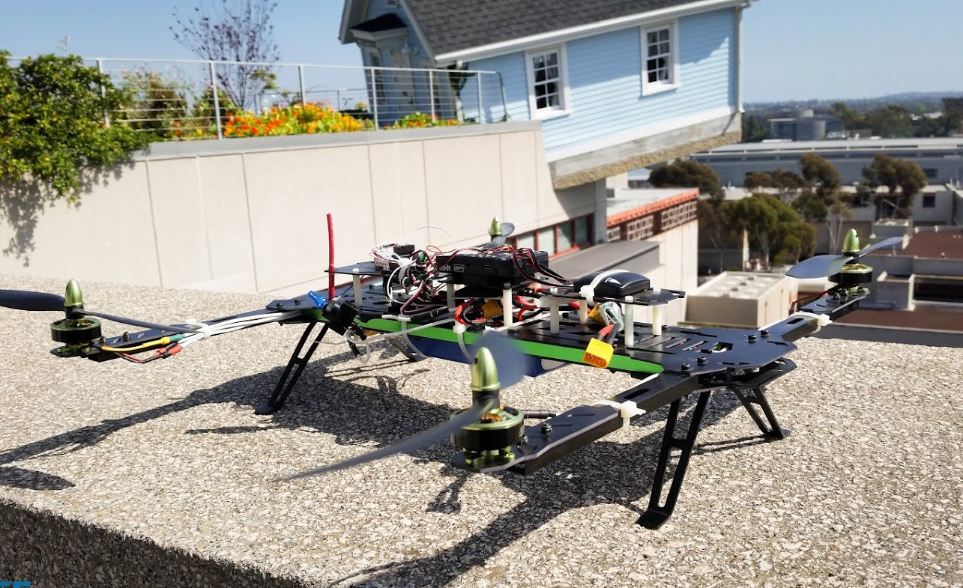
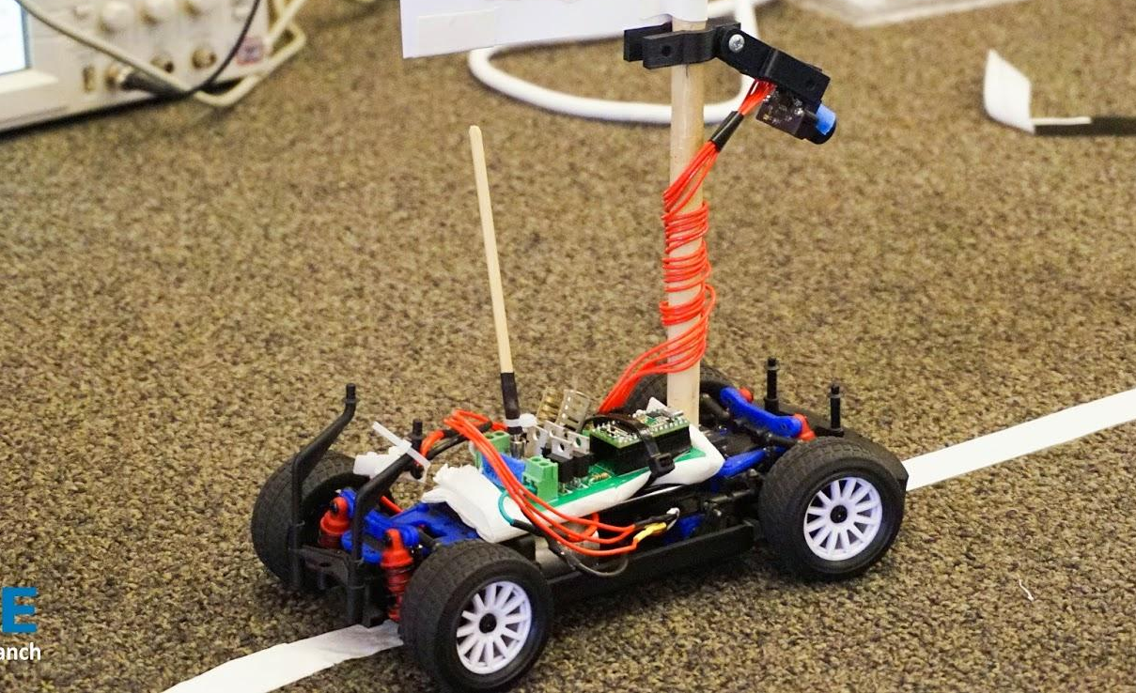
Our Projects
Projects are what students are most interested in!
All projects are autonomous robotics competitions
Teams utilize advanced methods in Control Systems, Data Processing, Machine Intelligence, Hardware, Algorithms, Team Management, and more.
We host annual competitions at UCSD (For Micromouse and Grand PrIEEE)
Robomagellan
Quadcopter
Micromouse
Grand PrIEEE

Slide 6
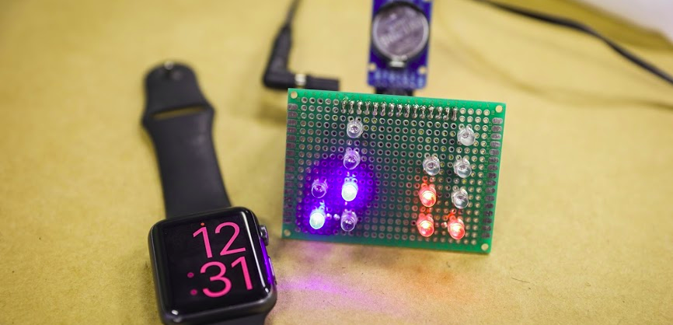
The Newest Addition
Quarterly Projects
Inspired by MIT Media Lab
Winter: Interactive, technology-driven art piece

Slide 7
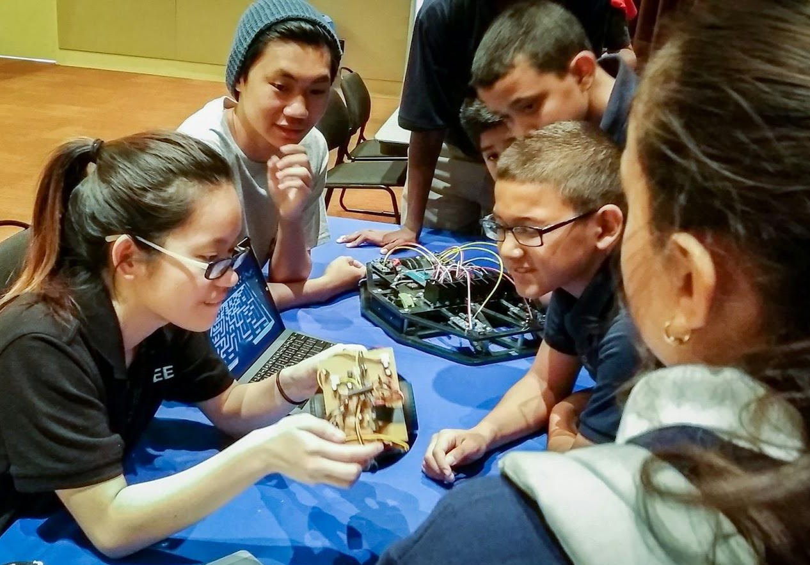
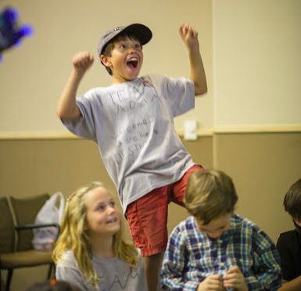
Forging an Active Community
Build a strong community through involvement
Our org is completely run by undergraduate students
Students can freely choose to be “staff members”
Outreach
Teach kids why STEM majors are awesome
First exposure to robotics, programming, circuits
New Monarch-School program

Slide 8
Getting Students to Love EE
Positive Environment
Officers and staff often become good friends
Our projects space is a home away from home
Fun social events to relieve stress
Awarding hard work
Students who demonstrate high achievement, or dedication are presented awards

Slide 9
More About Projects
AVC Sparkfun Project, IARC Quadcopter Project, Micromouse, Grand PrIEEE

Slide 10
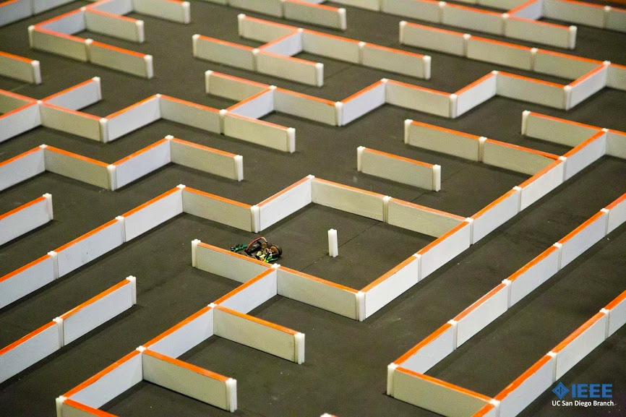
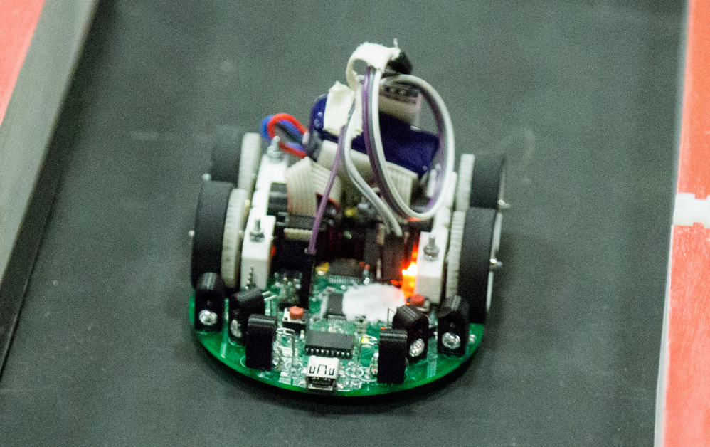
Micromouse
IEEE’s most popular project
A miniature robot designed to explore, then navigate, through an arbitrary maze
Competition with other mice for the fastest time to the center of the maze

Slide 11
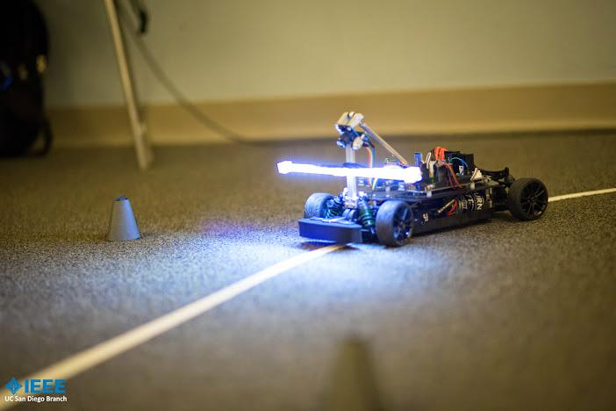
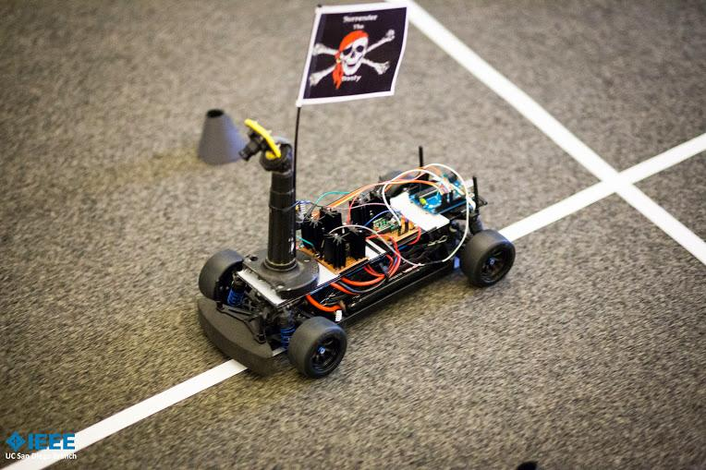
Grand PrIEEE
Design, build, and race an autonomous vehicle that navigates a track, no longer than 300 feet, overlaying an AC sinusoidal signal.
Electrical and mechanical design
Signal processing
Control theory

Slide 12
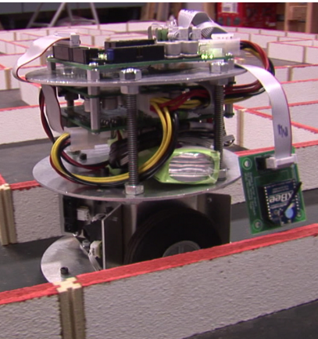
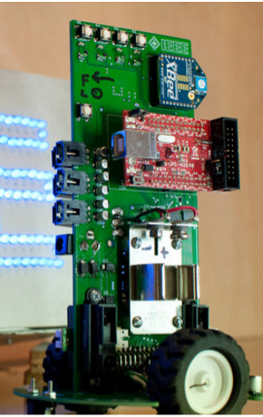
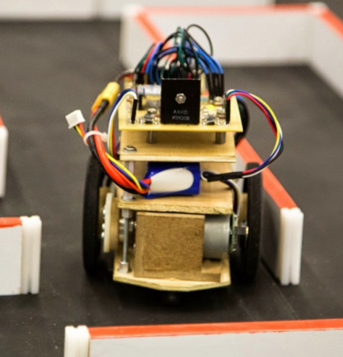
Progression of Technology
Micromouse
Mouses used to be quite bulky
Teams realized that smaller is faster

Slide 13
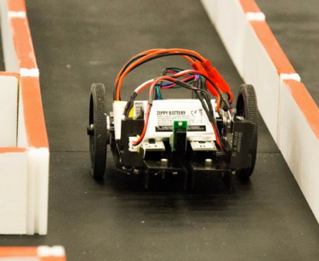
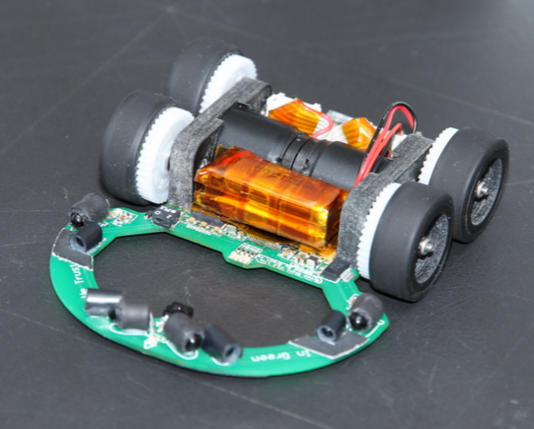
Progression of Technology
Micromouse cont.
Progress was made quickly
The modern mouse is highly optimized

Slide 14
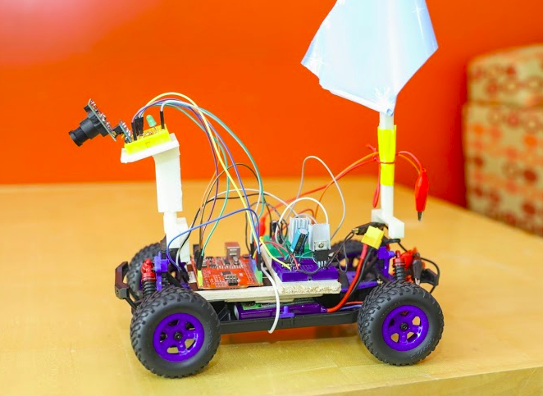
Progression of Technology
Grand PrIEEE
Teams used to use inductive coils for sensing electric current
Cameras can see further ahead, and are common nowadays.

Slide 15
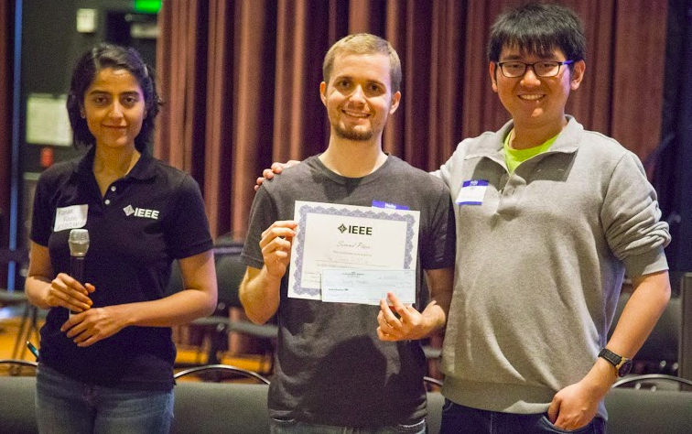
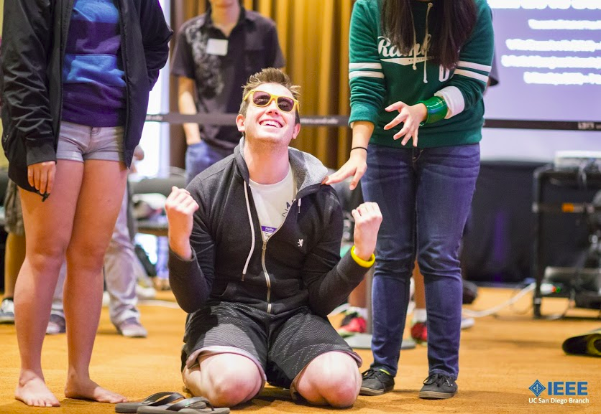
Emotions Run High
There is victory
... and Defeat

Slide 16
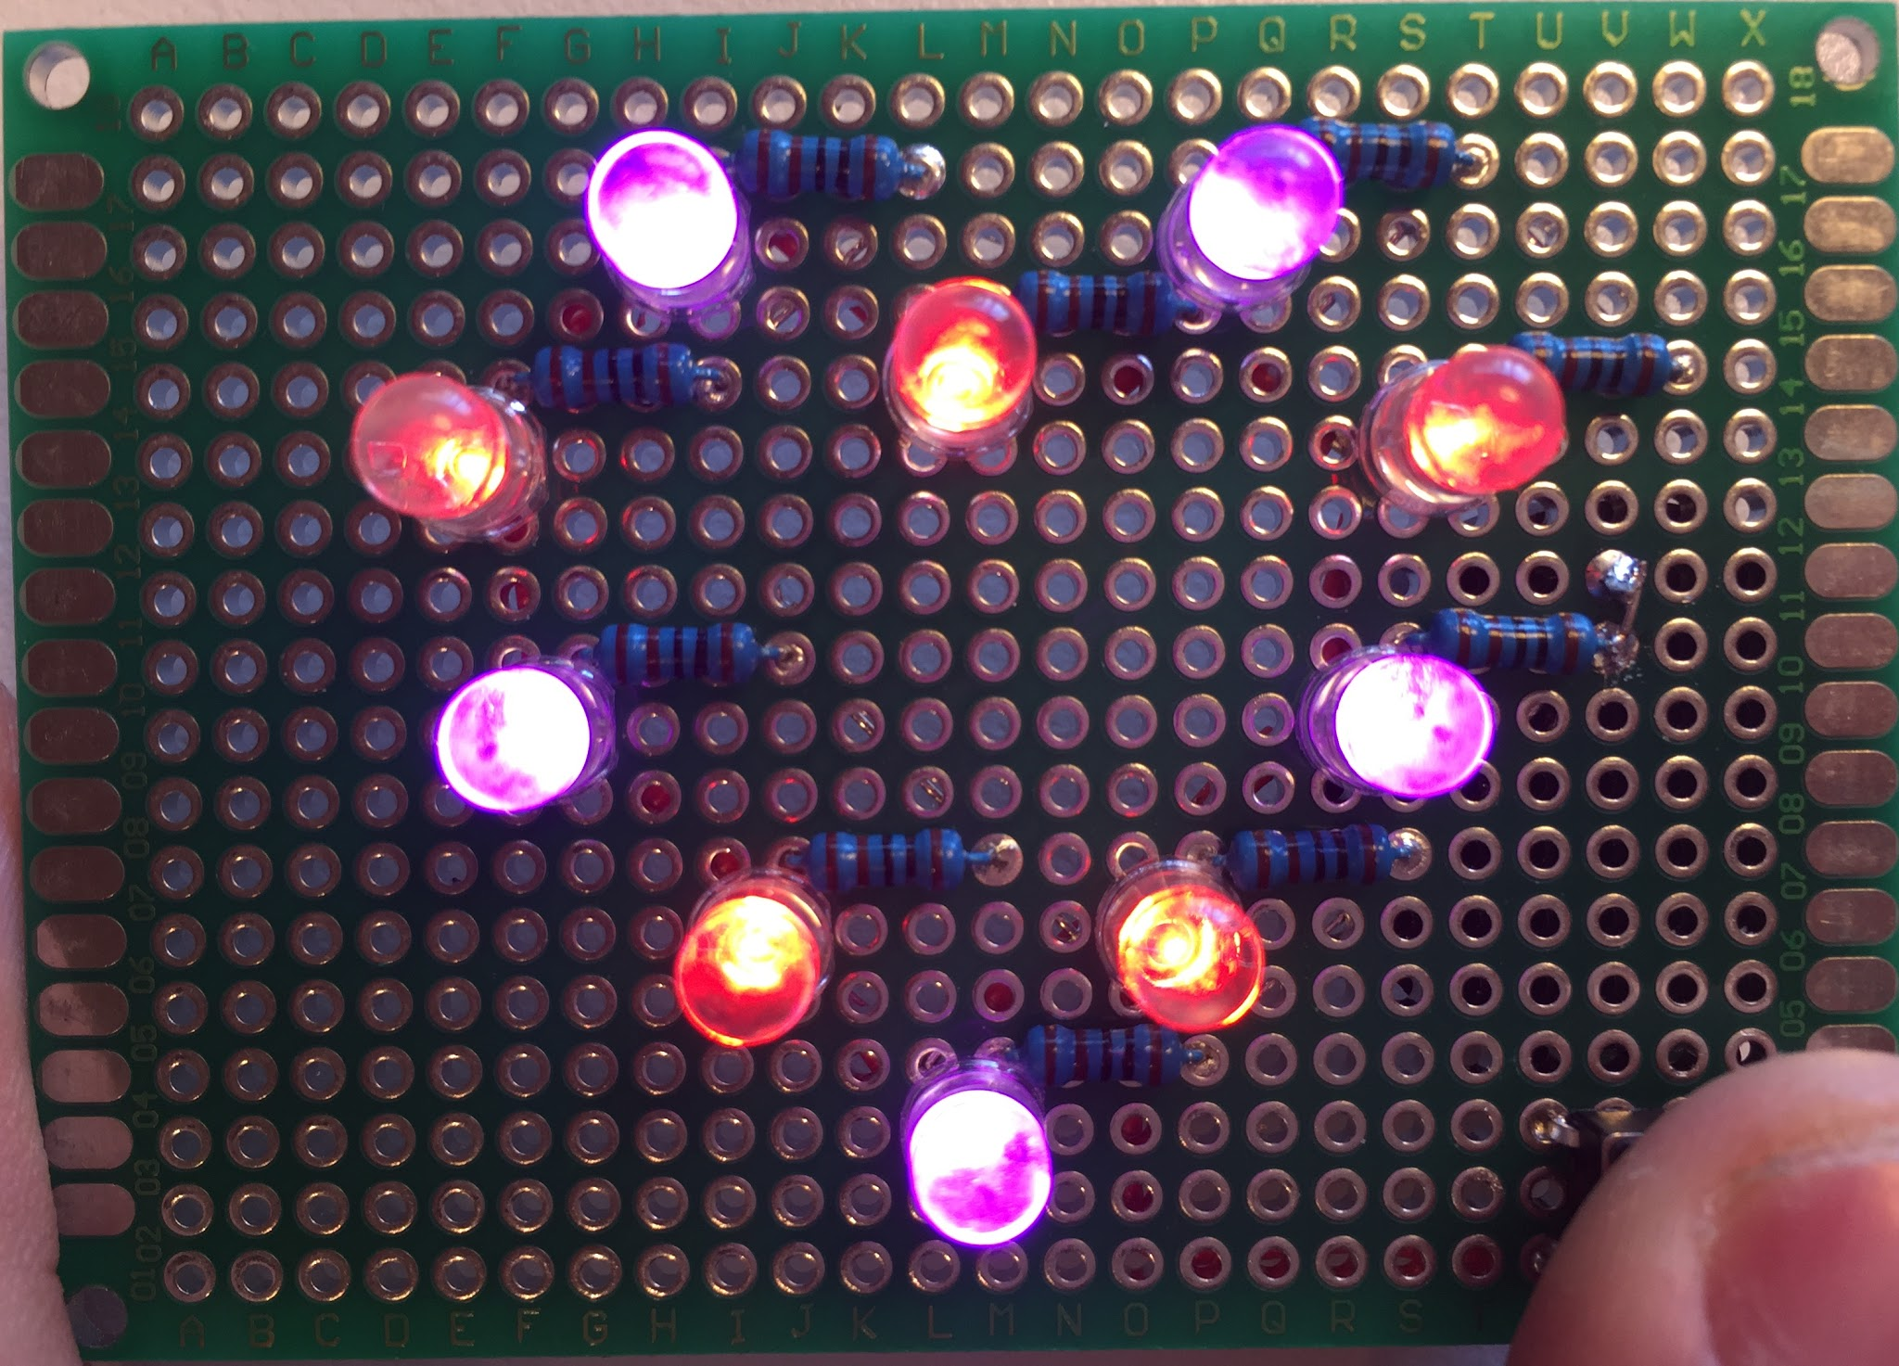
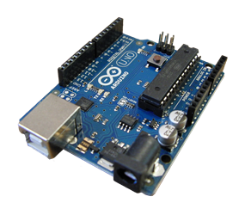
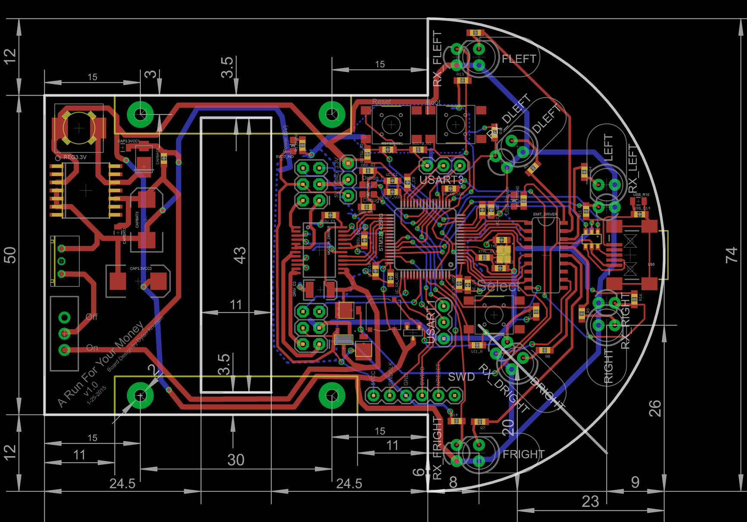
Our Technical Workshops
Hands-on Experience is what makes engineering so much fun!
Soldering Workshops
Arduino Workshops LEDs, switches, sensors
Circuit Board Design!

Slide 17
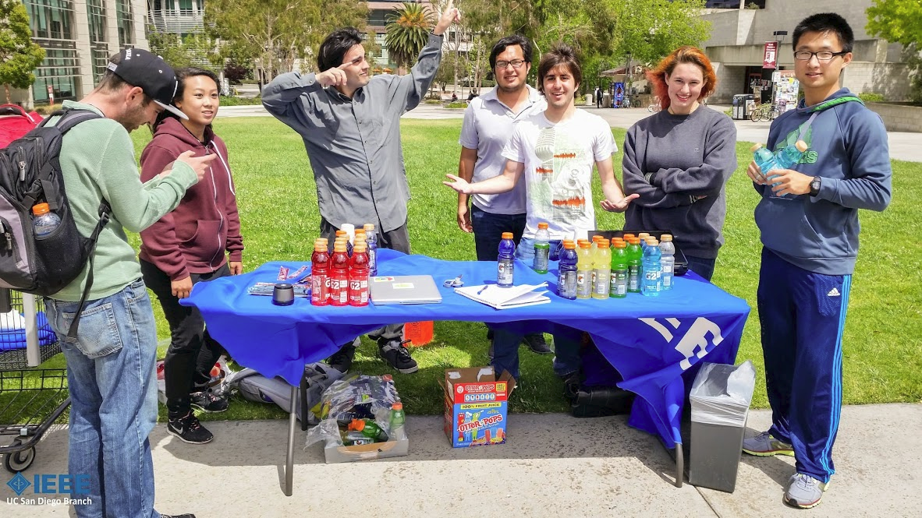
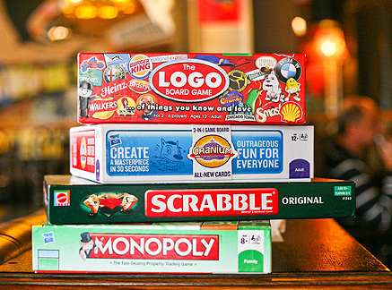
Social Events
Dragonboat Competiton
Relief from the daily grind
Ice Cream Socials
Board Game Nights

Slide 18
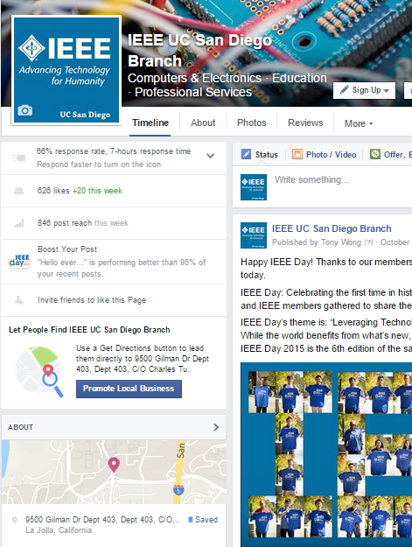
Adapting to the Age of the Internet
The internet has changed everything, and we want to help students stay relevant
We started a Facebook page where anyone can easily follow and interact with us
Revamped our website
Notes:
Mention LinkedIn

Slide 19
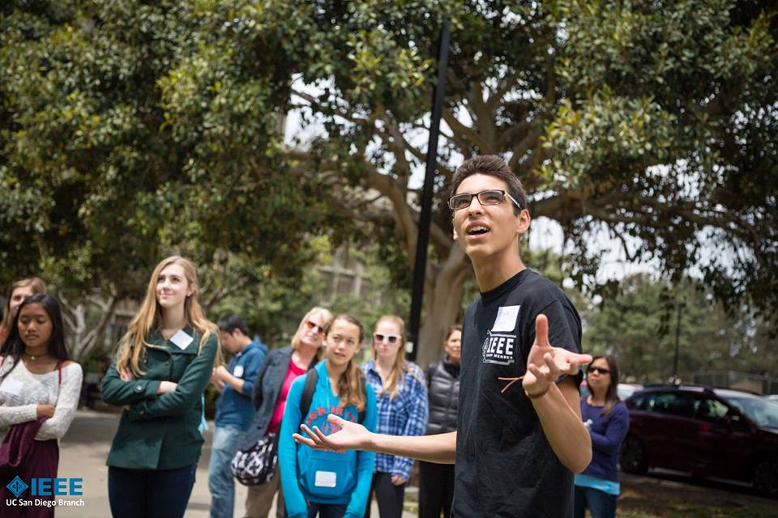
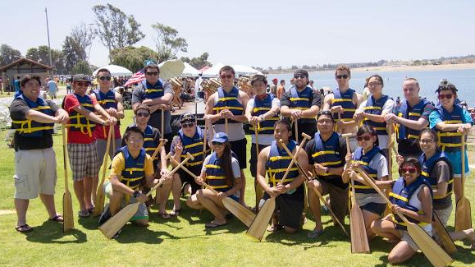
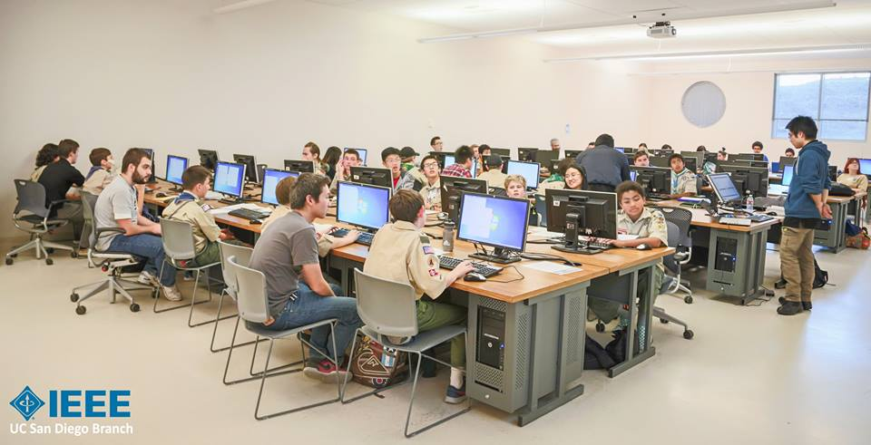
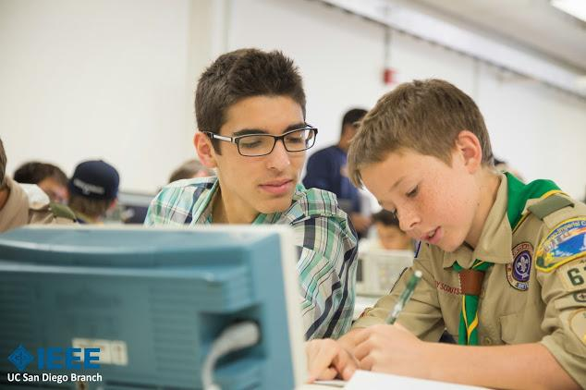
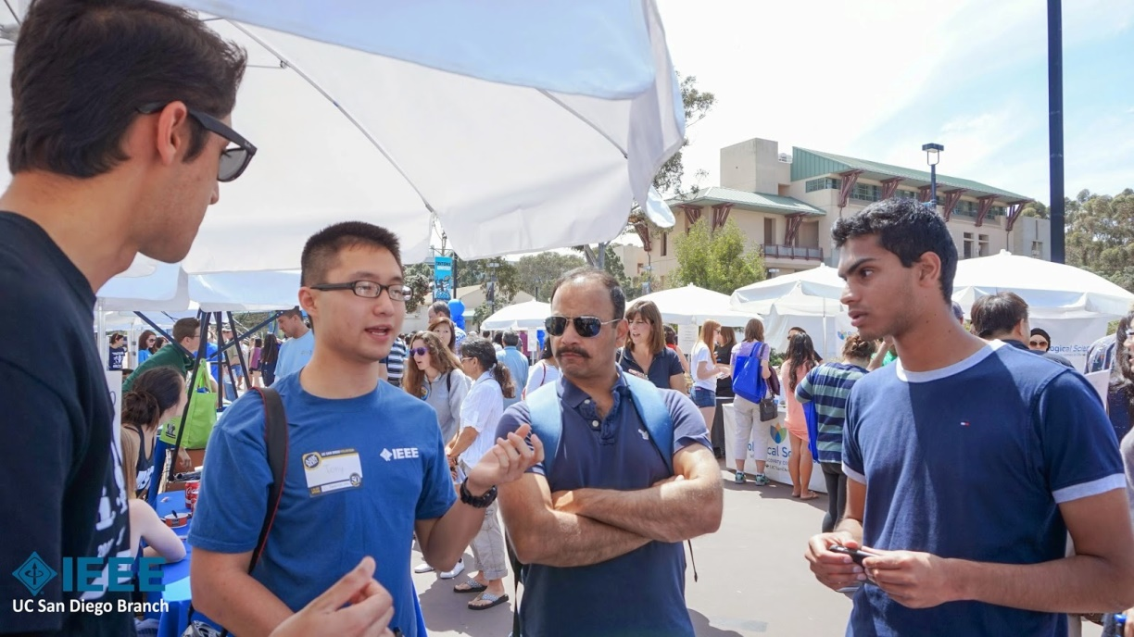
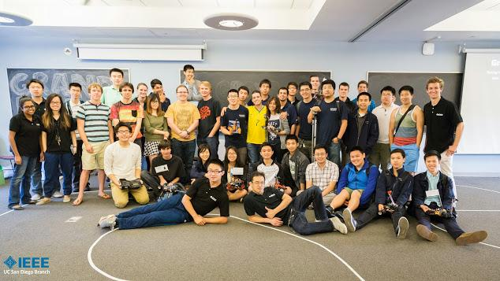
Closing
Thank you!
Our Website: ieee.ucsd.edu
Our Facebook: IEEE UC San Diego Branch

