Slide 1
The Benefits of Publishing with IEEE
Updated 2013
13-PROD-0073 Print Fix - Author PPT

Slide 2
Question:
Why are IEEE authors seen as
the best and the brightest today?
Notes:
Question: Why are IEEE authors seen as the best and the brightest today?

Slide 3



There are three major reasons:
Findability
Credibility
Flexibility
Notes:
There are three major reasons:
One, their works can be readily found. So, "findability" is a major asset.
Two, IEEE is a trusted source. "Credibility" is another IEEE author benefit.
Three, "flexibilty" of tools and publishing options.

Slide 4
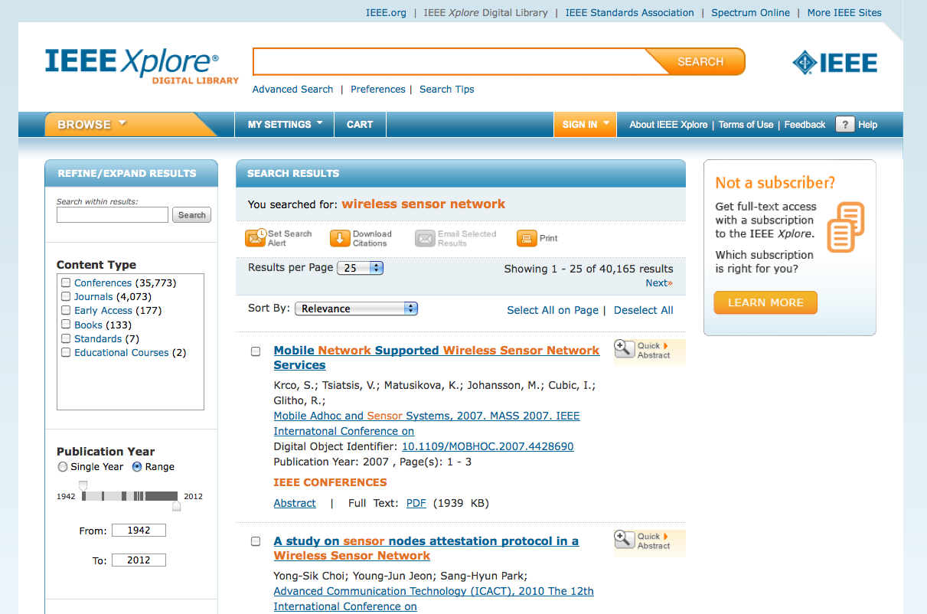
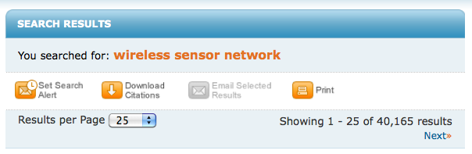
What is “findability” and why is it so important to authors?
Notes:
What exactly is Findability and why is it so important to authors?
Look at it from a researcher's point of view. If you consistently and quickly find the quality articles you need, you will return to that source time and again.
IEEE Xplore digital library optimizes this experience for researchers, so an author's work appears in the search results fast and in the proper context.

Slide 5


How much do researchers use
IEEE Xplore®?
An average of seven million documents each month are downloaded from IEEE Xplore.
That’s over
11,000 downloads
in this hour alone
Notes:
How much do researchers use IEEE Xplore?
An average of seven million documents each month are downloaded from IEEE Xplore.
That is over 11,000 downloads in this hour alone. [maybe just show the slide]
That kind of activity positively reflects on the quality of author content.

Slide 6







What else increases an IEEE author’s findabilty?
IEEE’s relationships with indexing and abstracting providers
Notes:
What else increases an IEEE author's findabilty?
IEEE's active relationships with indexing and abstracting providers increase opportunities to access IEEE content.
Partners include: Google indexing, CrossRef, Elsevier , Thomson Reuters, ProQuest, IET, NLM
All help to maximize the visibility of IEEE authors' works.

Slide 7
IEEE also makes available various types of open access publications
IEEE Open Access
Hybrid
Journals
Subscription-based
and Open Access
Fully Open
Access Journals
Devoted to One
Technology Topic
Mega
Journal
Multidisciplinary
Open Access
Notes:
IEEE also makes available various types of open access publications for authors, many free to readers, such as
-- Hybrid Journals: Subscription-based and Open Access
-- Mega Journal: Multidisciplinary Open Access
-- Fully Open Access Journals: Devoted to One Technology Topic
Open access is an active area for publishers, authors, and researchers alike.

Slide 8
New Question:
What builds author credibility?
Notes:
An new question: What builds author credibility?

Slide 9
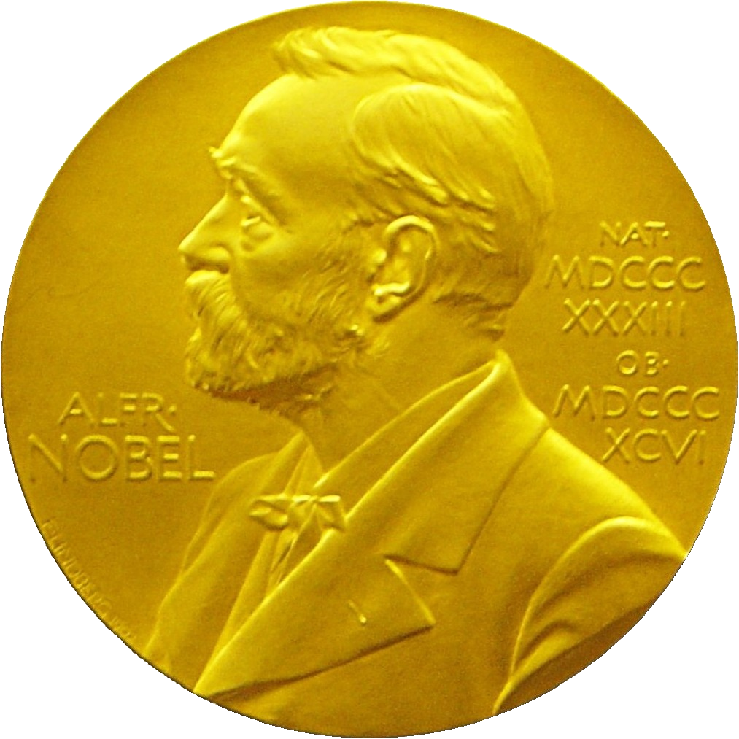
For more than 125 years…
IEEE has been the trusted source for researchers in academia, corporations, and government
  Past and present IEEE Members include nearly two dozen Nobel Prize-winning innovators
Notes:
For over 125 years, IEEE has been the trusted source for researchers in academia, corporations, and government.
Each author becomes part of IEEE's stellar reputation. Past and present IEEE Members include nearly two dozen Nobel Prize-winning innovators.
Consistent quality and high demand have made IEEE the researcher's choice and the optimum publisher for authors around the world.

Slide 10
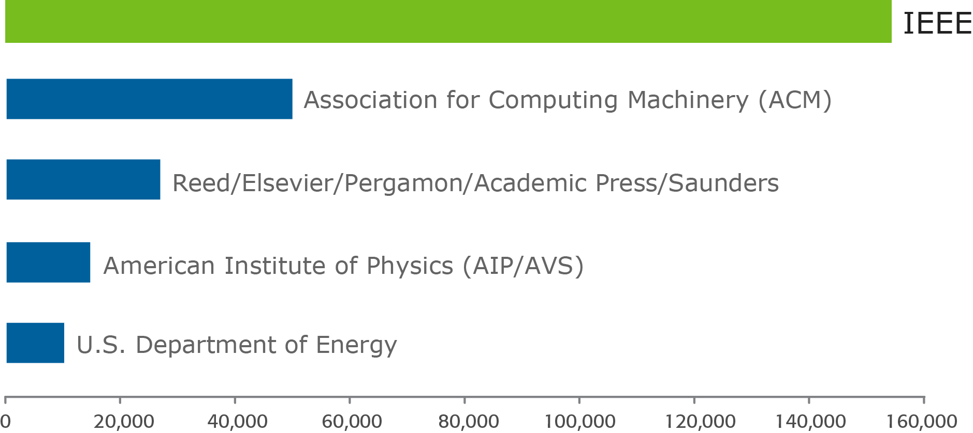
Patent references from the top five STM publishers
IEEE is cited 3x more often than the nearest competition
Source: 1790 Analytics LLC, Copyright 2012
Notes:
Year after year, IEEE journals and conference proceedings receive nearly three times the patent citations of competing publishers.
This gives IEEE authors a distinct mark of credibility within their field of interest.
Singling out academia, we find that IEEE is cited nearly five times more than other publishers.

Slide 11

IEEE peer review ensures high quality of every article submitted
Notes:
Supporting the credibility of IEEE authors and their works is the peer review process, which is designed to ensure the high quality of every article submitted to and published by IEEE.
This is another reason why IEEE authored publications are preferred by researchers worldwide.

Slide 12
IEEE publishing can connect authors with other leading voices
innovators
authors
librarians
researchers
innovators
researchers
innovators
librarians
Notes:
Authors are not on their own with IEEE. IEEE Publishing can connect authors with other leading voices in technology specialties for meaningful collaborations.
Other author tools are available to help manage workflow and overall publish your writing for readers and researchers. I will expand on this later.

Slide 13

A milestone directly related to the credibility of content
IEEE Xplore surpassed
3 million documents
Authors add more than
1,000 articles daily
Notes:
In 2011, IEEE achieved a milestone that was directly related to the credibility of its content.
The IEEE Xplore digital library, one of the world’s largest collections of high quality technical literature in engineering and technology, surpassed three million documents.
Now, authors add more than 1,000 articles daily.

Slide 14
Final Topic:
Flexibility in the publishing process
Notes:
Our final topic is flexibility in the publishing process.
This is the author's wheelhouse, where diverse opportunities are available to optimize the publishing process from start to post-pub.

Slide 15
What are the opportunities to publish at IEEE?
160⁺
Journals, Transactions, Magazines
1,200⁺
Conferences
Authors can be “found” where their work belongs.
Notes:
What are the opportunities to publish at IEEE?
IEEE's 160+ journals, transactions, magazines, and more than 1,200 conferences around the world allow authors to find the best forum for their work.
This wealth of information allows researchers to find exactly what they need among the more than three million documents in IEEE Xplore.
Authors can be "found" where their work belongs.

Slide 16
IEEE’s Web-based workflow includes electronic submission
ScholarOne Manuscripts®
  Shortens the time from submission to IEEE publication
  Helps authors track a paper’s progress
IEEE publishes articles, not issues
Notes:
What about the editorial process and the author tools mentioned before?
IEEE’s Web-based workflow includes electronic submission via ScholarOne Manuscripts®.
This process has shortened the time from submission to IEEE publication. It also helps authors track a paper’s progress.
Remember, too, that IEEE publishes articles, not issues, so there is no additional waiting for an entire journal issue to be assembled.

Slide 17
The IEEE Digital Author Toolbox is a robust resource
It contains:
Tools and information to assist with article preparation and submission
Templates
A style guide
The article proof procedure
How to order reprints
Many frequently asked questions and more
Authorship with IEEE is a comprehensive experience.
Notes:
The IEEE Digital Author Toolbox is a robust resource. It contains
-- tools and information to assist with article preparation and submission
-- templates
-- a style guide
-- the article proof procedure
-- how to order reprints
-- many frequently asked questions and more
Authorship with IEEE is a comprehensive experience.

Slide 18
To make a successful author and an effective paper:
People need
to find you.
They need to trust what
they find.
That trust motivates them to return.
Notes:
Now, you realize that it takes much more than words to make a successful author and effective paper:
--People need to find you.
--They need to trust what they find.
--That trust motivates them to return.
--And whether an author is new or seasoned, you need a process that optimizes the publishing experience and makes your work available exactly where it belongs.
That is the formula for successful authorship.

Slide 19

Thank You.
IEEE would like you to reach your full potential as a published author.
Visit www.ieee.org/go/authorship
Browse www.ieee.org/ieeexplore
Notes:
IEEE is very proud of its authors, and we would relish the opportunity to help you reach your full potential as a published author.
I'd like to invite you to visit our helpful authorship page on ieee.org.
Also, feel free to browse IEEE Xplore digital library. As an IEEE author, you will see that you are among very good company indeed.
Thank you.

